Slide 1
Numerical Analysis & Computer Programming
With Python
Part 2: Numerical Analysis
P. Arumugam (आरुमुगम)
Department of Physics
arumugam@ph.iitr.ac.in
Phone: 8979890366

Slide 2
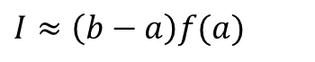
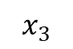
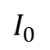
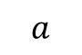
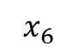
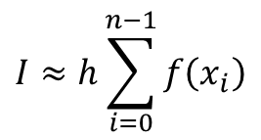
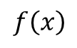
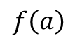
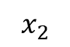
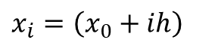
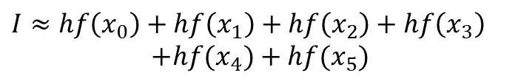
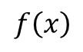
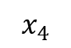
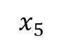
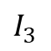
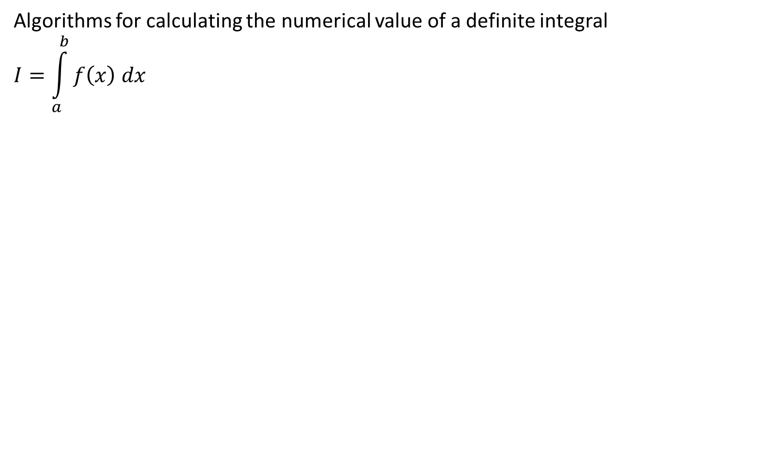
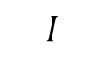
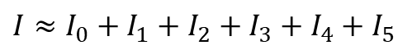
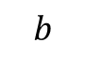
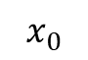
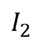
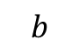
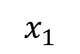
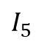
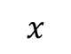
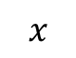
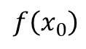
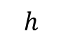
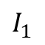
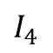
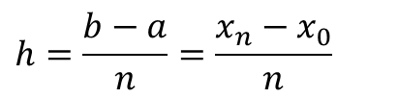
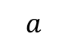
Numerical integration
Algorithms for calculating the numerical value of a definite integral
$$I=\int_{a}^{b}{f\left(x\right) dx}$$
$$f\left(x\right)$$
$$f\left(a\right)$$
$I≈\left(b−a\right)f(a)$
Rectangle rule!
$$I$$
$${x=x}_{0},x_{1},x_{2},x_{3},x_{4},x_{5},x_{6}$$
$${x=x}_{0},x_{0}+h,x_{0}+2h,x_{0}+3h,…$$
$$a$$
$$b$$
$$x$$
$$x_{i}=\left(x_{0}+ih\right)$$
$$f\left(x\right)$$
$$I≈I_{0}+I_{1}+I_{2}+I_{3}+I_{4}+I_{5}$$
$$f\left(x_{0}\right)$$
$$I≈hf\left(x_{0}\right)+hf\left(x_{1}\right)+hf\left(x_{2}\right)+hf\left(x_{3}\right)$$
$$+hf(x_{4})+hf(x_{5})$$
$$I_{0}$$
$$I_{1}$$
$$I_{2}$$
$$I_{3}$$
$$I_{4}$$
$$I_{5}$$
$$h$$
$$I≈h\sum_{i=0}^{n−1}{f\left(x_{i}\right)}$$
$$h=\frac{b−a}{n}=\frac{x_{n}−x_{0}}{n}$$
$$a$$
$$b$$
$$x$$
$$x_{0}$$
$$x_{1}$$
$$x_{2}$$
$$x_{3}$$
$$x_{4}$$
$$x_{5}$$
$$x_{6}$$
Cumulative rectangle rule!

Slide 3
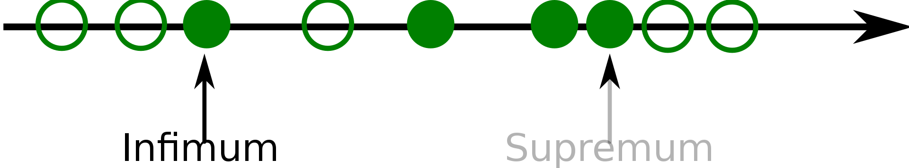
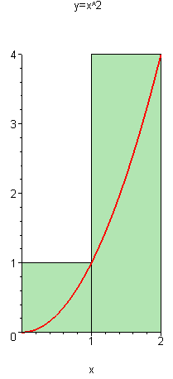
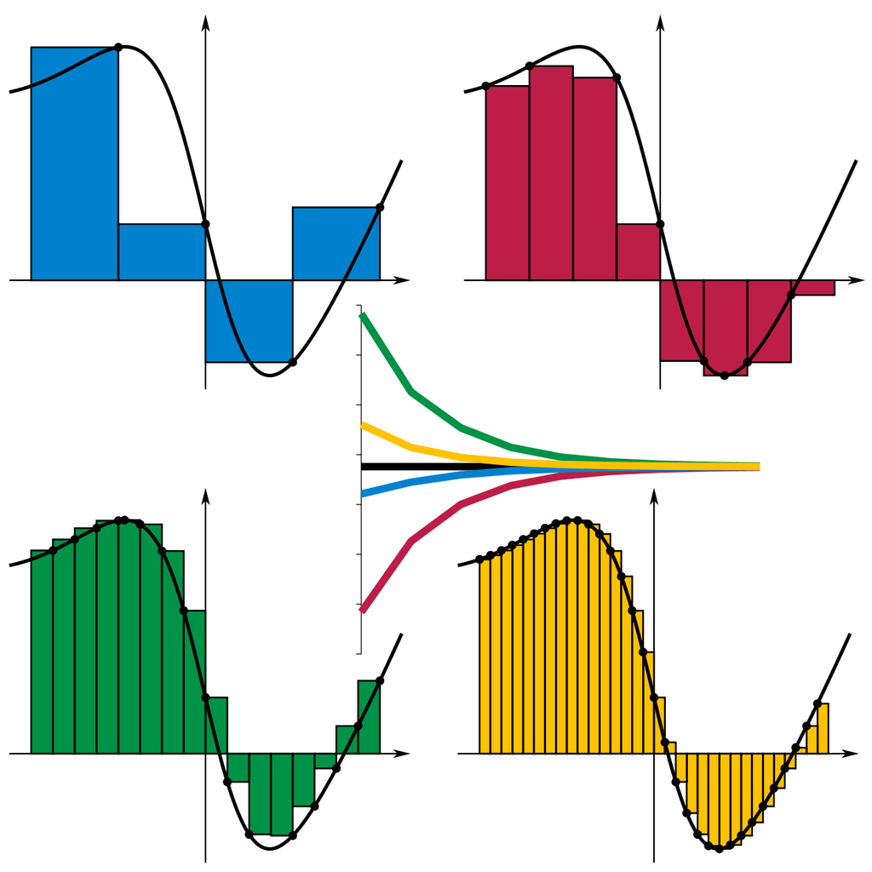
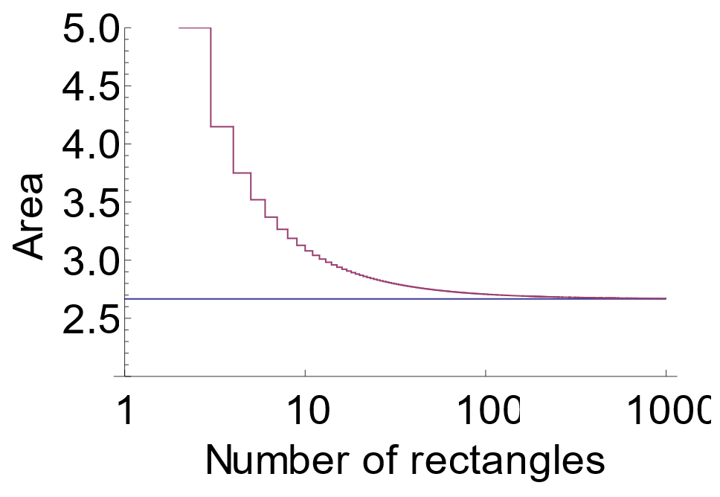

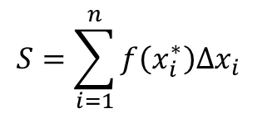
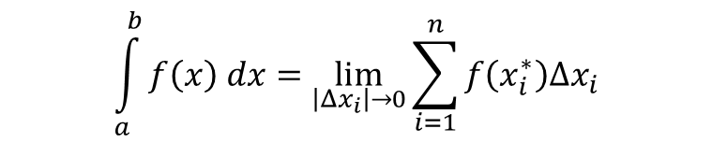
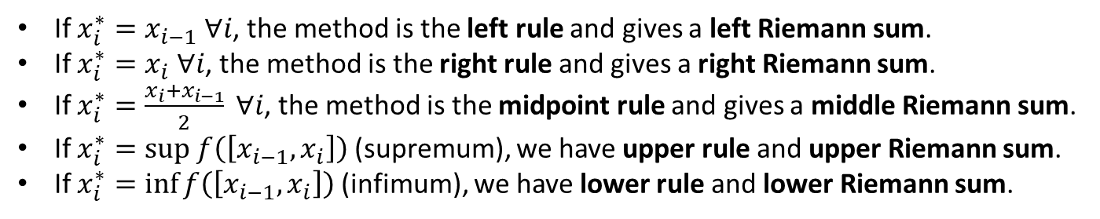
Reiman sum
$$S=\sum_{i=1}^{n}{f\left(x_{i}^{∗}\right)Δx_{i}}$$
where $Δx_{i}=x_{i}−x_{i−1}$ and $x_{i}^{∗}∈\left[x_{i−1},x_{i}\right]$
If $x_{i}^{∗}=x_{i−1} ∀i$, the method is the left rule and gives a left Riemann sum.
If $x_{i}^{∗}=x_{i} ∀i$, the method is the right rule and gives a right Riemann sum.
If $x_{i}^{∗}=\frac{x_{i}+x_{i−1}}{2} ∀i$, the method is the midpoint rule and gives a middle Riemann sum.
If $x_{i}^{∗}=sup f\left(\left[x_{i−1},x_{i}\right]\right)$(supremum), we have upper rule and upper Riemann sum.
If $x_{i}^{∗}=\inf{f\left(\left[x_{i−1},x_{i}\right]\right)}$(infimum), we have lower rule and lower Riemann sum.
$$\int_{a}^{b}{f\left(x\right) dx}=\lim_{\left|Δx_{i}\right|→0}{\sum_{i=1}^{n}{f\left(x_{i}^{∗}\right)Δx_{i}}}$$

Slide 4
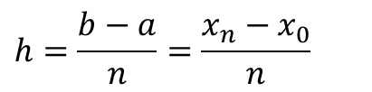
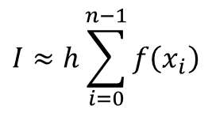
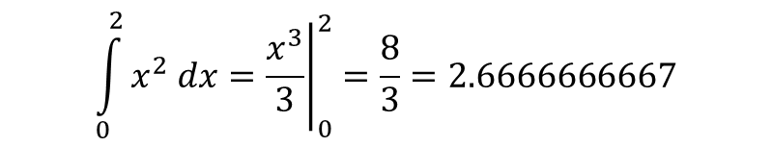
Code for rectangle rule
$$I≈h\sum_{i=0}^{n−1}{f\left(x_{i}\right)}$$
$$\int_{0}^{2}{x^{2} dx}={\left.\frac{x^{3}}{3}\right|}_{0}^{2}=\frac{8}{3}=2.6666666667$$
$$h=\frac{b−a}{n}=\frac{x_{n}−x_{0}}{n}$$
def f(x):
return x**2
a,b = 0,2
n = 100
h = (b - a) / n
sum = 0
for i in range(n):
x_i = a + i*h
sum += h*f(x_i)
print(“I:", sum)
def Int_R(func, a, b, n):
h = (b - a) / n
sum=0
for i in range(n):
sum += h*func(a+i*h)
return sum
def f(x):
return x**2
print(“I:",Int_R(f,0,2,100))
import numpy as np
def Int_R(x,y):
h=(x[-1]-x[0])/(len(x)-1)
sum=0
for yi in y:
sum += h*yi
sum -= h*yi
return sum
x=np.arange(0,2.01,0.02);y=x**2
print("I:",Int_R(x,y))
I: 2.626800000000000
def Int_R(x,y):
h=(x[-1]-x[0])/(len(x)-1)
return h*(sum(y)-y[-1])

Slide 5
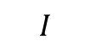
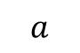
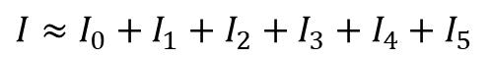
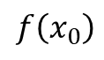
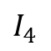
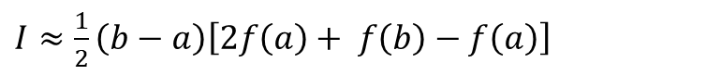
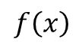
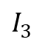















Trapezoidal rule
$I≈\left(b−a\right)f(a)$
Rectangle rule!
$$f\left(x\right)$$
$I≈\left(b−a\right)f\left(a\right)+\frac{1}{2}\left(b−a\right)\left[f\left(b\right)−f\left(a\right)\right]$
$$f\left(b\right)$$
$$f\left(b\right)−f\left(a\right)$$
$I≈\frac{1}{2}\left(b−a\right)\left[2f\left(a\right)+ f\left(b\right)−f\left(a\right)\right]$
$$f\left(a\right)$$
$I≈\frac{1}{2}\left(b−a\right)\left[f\left(a\right)+ f\left(b\right)\right]$
$$I$$
Trapezoidal rule!
$$a$$
$$b$$
$$x$$
$$I≈I_{0}+I_{1}+I_{2}+I_{3}+I_{4}+I_{5}$$
$$f\left(x\right)$$
$$I≈\frac{h}{2}\left[f\left(x_{0}\right)+f\left(x_{1}\right)\right]+\frac{h}{2}\left[f\left(x_{1}\right)+f\left(x_{2}\right)\right]$$
$$+\frac{h}{2}\left[f\left(x_{2}\right)+f\left(x_{3}\right)\right]+…$$
$$f\left(x_{0}\right)$$
$$I_{0}$$
$$I_{1}$$
$$I_{2}$$
$$I_{3}$$
$$I_{4}$$
$$I_{5}$$
$$I≈\frac{h}{2}\sum_{i=0}^{n−1}{f\left(x_{i}\right)+f\left(x_{i+1}\right)}$$
$$h$$
$$a$$
$$b$$
$$x$$
Cumulative trapezoidal rule!
$$x_{0}$$
$$x_{1}$$
$$x_{2}$$
$$x_{3}$$
$$x_{4}$$
$$x_{5}$$
$$x_{6}$$

Slide 6






Code for trapezoidal rule
def Int_R(x,y): #Rectangle rule
h=(x[-1]-x[0])/(len(x)-1)
return h*(sum(y)-y[-1])
$$I≈\frac{h}{2}\sum_{i=0}^{n−1}{f\left(x_{i}\right)+f\left(x_{i+1}\right)}$$
$$I≈\frac{h}{2}\left[f\left(x_{0}\right)+f\left(x_{1}\right)\right]+\frac{h}{2}\left[f\left(x_{1}\right)+f\left(x_{2}\right)\right]+…$$
import numpy as np
def Int_R(x,y):
h=(x[-1]-x[0])/(len(x)-1)
sum=0
for i in range(len(y)-1):
sum += 0.5*h*(y[i]+y[i+1])
return sum
x=np.arange(0,2.01,0.02)
y=x**2
print("I:",Int_R(x,y))
$$I≈\frac{h}{2}\left[f\left(x_{0}\right)+2f\left(x_{1}\right)+2f\left(x_{2}\right)+…+2f\left(x_{n−1}\right)+f\left(x_{n}\right)\right]$$
$$I≈\frac{h}{2}\left[f\left(x_{0}\right)+f\left(x_{n}\right)\right]+h\left[f\left(x_{1}\right)+f\left(x_{2}\right)+…+f\left(x_{n−1}\right)\right]$$
$$I≈h\left[f\left(x_{0}\right)+f\left(x_{1}\right)+…+f\left(x_{n}\right)\right]−\frac{h}{2}\left[f\left(x_{0}\right)+f\left(x_{n}\right)\right]$$
$$I≈h\left\{\sum_{i=0}^{n}{f\left(x_{i}\right)}−\frac{1}{2}\left[f\left(x_{0}\right)+f\left(x_{n}\right)\right]\right\}$$
I: 2.6668
def Int_R(x,y):
h=(x[-1]-x[0])/(len(x)-1)
return h*(sum(y)- 0.5*(y[0]+y[-1]))
I: 2.6668000000000003

Slide 7












Simpson’s Rule

Slide 8



Simpson’s Rule – composite form
Consider

Slide 9
Wikipedia code (older version)
def simpson(f, a, b, n):
if n % 2:
raise ValueError("n must be even (received n=%d)" % n)
h = (b - a) / n
s = f(a) + f(b)
for i in range(1, n, 2):
s += 4 * f(a + i * h)
for i in range(2, n-1, 2):
s += 2 * f(a + i * h)
return s * h / 3
# Demonstrate that the method is exact for polynomials up to 3rd order
print(simpson(lambda x:x**3, 0.0, 10.0, 2)) # 2500.0
print(simpson(lambda x:x**3, 0.0, 10.0, 100000)) # 2500.0
print(simpson(lambda x:x**4, 0.0, 10.0, 2)) # 20833.3333333
print(simpson(lambda x:x**4, 0.0, 10.0, 100000)) # 20000.0

Slide 10
A better code
from numpy import *
def simp(x,y):
n=len(x)
if(n!=len(y)):
raise ValueError('Len of x(=%d) & y(=%d) should match' % (n,len(y)))
elif(mod(n,2)=0):
raise ValueError('Len of x & y (=%d) should be an odd number' % n)
h=abs(x[n-1]-x[0])/float(n-1)
sum2=h*(y[0]+y[n-1])/3.0
for i in range(1,n-1):
sum2+=h*y[i]*2.0*(1.0+mod(i,2))/3.0
return sum1
x=1.0*array(range(9))
y=x**2+2.0*x
print simp(x,y),8**3/3.0+8**2

Slide 11

Another better code
from numpy import *
def simp(x,y):
n=len(x)
h=abs(x[n-1]-x[0])/float(n-1)
c=(mod(range(n),2)+1)*2
c[0]=1
c[n-1]=1
sum1=sum(h*c*y/3.0)
return sum1
x=1.0*array(range(9))
y=x**2+2.0*x
print simp(x,y),8**3/3.0+8**2
$$\int_{a}^{b}{f\left(x\right) dx}=\frac{h}{3}\left[f\left(x_{0}\right)+4f\left(x_{1}\right)+2f\left(x_{2}\right)+4f\left(x_{3}\right)+…+4f\left(x_{n−1}\right)+f\left(x_{n}\right)\right]$$

Slide 12
Some notes about numerical integration
The trapezoidal rule is one of a family of formulas for numerical integration called Newton–Cotes formulas, of which the midpoint rule is similar to the trapezoid rule.
Simpson's rule is another member of the same family and generally has faster convergence than the trapezoidal rule for functions which are twice continuously differentiable, though not in all specific cases.
Simpson’s rule is exact for functions up to cubic. A proof is available in http://10.14.0.51/~aru/ph643/6.%20Simpson's%20Rule%20is%20Exact%20for%20Cubics%20-%20A%20Simple%20Proof.pdf
However, for various classes of rougher functions (ones with weaker smoothness conditions), the trapezoidal rule generally has faster convergence than Simpson's rule.
Moreover, the trapezoidal rule tends to become extremely accurate when periodic functions are integrated over their periods. A similar effect can be seen for peak functions.
For non-periodic functions, however, methods with unequally spaced points such as Gaussian quadrature are generally far more accurate.

Slide 13





Interpolation
$$f(x1)=y1$$
$$f(x2)=y2$$
$$f\left(x3\right)=y3$$
$$⋮$$
$$f(xm)=ym$$
An Interpolating Function for a set of data: $\{(x1,y1),(x2,y2),(x3,y3)…(xm,ym)\}$is a function $f(x)$ that satisfies:
$$f\left(−2\right)=−39$$
$$f\left(−1\right)=−4$$
$$f\left(0\right)=5$$
$$⋮$$
$$f(2.5)=31.875$$
E.g. data: {(-2, -39), (-1, -4), (0, 5), (1, 6), (2, 17), (2.5, 31.875)}
x=[-2,-1,0,1,2,2.5]
y=[-39,-4,5,6,17,31.875]
plt.plot(x,y,'o')
plt.plot(x,y,'o-')

Slide 14

Interpolating Data with a Function
Problem statement:
Given a set of data points $\{(x1,y1),(x2,y2),(x3,y3)…(xm,ym)\}$, how can an interpolating function $f(x)$be constructed to fit the data.
The data set should satisfy the condition $x_{i}≠x_{j}$ if $i  j$.
Polynomial Interpolation
$$f\left(x\right)=a_{n}x^{n}+a_{n−1}x^{n−1}+a_{n−2}x^{n−2}+…+a1x+a0$$
Degree of Polynomial Interpolation
The degree of a polynomial $p\left(x\right)=a_{n}x^{n}+a_{n−1}x^{n−1}+a_{n−2}x^{n−2}+…+a1x+a0$is the largest exponent with a non-zero coefficient.
The degree of the polynomial required is less than the number of data points. Generally, a data set of $m$ points will require a polynomial of degree $m−1$ or less.

Slide 15








Lagrange Interpolating Polynomial
Data Set
Polynomial
The Lagrange Form of an interpolating polynomial makes use of elimination of terms and cancellation to fit the data set.
$$\left\{(x_{1},y_{1})\right\}$$
$$p(x)=y_{1}$$
$$p(x)=y_{1}\frac{(x−x_{2})}{(x_{1}−x_{2})}+y_{2}\frac{(x−x_{1})}{(x_{2}−x_{1})}$$
$$\left\{(x_{1},y_{1}),(x_{2},y_{2})\right\}$$
$$\left\{(x_{1},y_{1}),(x_{2},y_{2}),(x_{3},y_{3})\right\}$$
$$p(x)=y_{1}\frac{(x−x_{2})(x−x_{3})}{(x_{1}−x_{2})(x_{1}−x_{3})}+y_{2}\frac{(x−x_{1})(x−x_{3})}{(x_{2}−x_{1})(x_{2}−x_{3})}+y_{3}\frac{(x−x_{1})(x−x_{2})}{(x_{3}−x_{1})(x_{3}−x_{2})}$$
$$\left\{\left(x_{1},y_{1}\right),\left(x_{2},y_{2}\right),⋯,\left(x_{m},y_{m}\right)\right\}$$
$$p\left(x\right)=y_{1}\frac{\left(x−x_{2}\right)\left(x−x_{3}\right)⋯\left(x−x_{m}\right)}{\left(x_{1}−x_{2}\right)\left(x_{1}−x_{3}\right)⋯\left(x_{1}−x_{m}\right)}+y_{2}\frac{\left(x−x_{1}\right)\left(x−x_{3}\right)⋯\left(x−x_{m}\right)}{\left(x_{2}−x_{1}\right)\left(x_{2}−x_{3}\right)⋯\left(x_{2}−x_{m}\right)}$$
$$+⋯+y_{m}\frac{(x−x_{1})(x−x_{2})⋯(x−x_{m−1})}{(x_{m}−x_{1})(x_{m}−x_{2})⋯(x_{m}−x_{m−1})}$$
$$p(x)=\sum_{i=1}^{m}{y_{i}\prod_{\begin{aligned}&j=1 \\ &j≠i\end{aligned}}^{m}{\frac{(x−x_{j})}{(x_{i}−x_{j})}}}$$

Slide 16



Validation with example
$$p(x)=\sum_{i=1}^{m}{y_{i}\prod_{\begin{aligned}&j=1 \\ &j≠i\end{aligned}}^{m}{\frac{(x−x_{j})}{(x_{i}−x_{j})}}}$$
Data: $\{(−1,−4),(0,−5),(1,−2)\}$
$$p(x)=−4\frac{(x−0)(x−1)}{(−1−0)(−1−1)}+−5\frac{(x+1)(x−1)}{(0+1)(0−1)}+−2\frac{(x+1)(x−0)}{(1+1)(1−0)} \\ =\frac{−4}{2}\left(x^{2}−x\right)+\frac{−5}{−1}\left(x^{2}−1\right)+\frac{−2}{2}\left(x^{2}+x\right) \\ =−2x^{2}+2x+5x^{2}−5−x^{2}−x \\ =2x^{2}+x−5$$
Plugging in the values of x, we get:
$$p(−1) = 2(−1)2 + −1 −5 = 2−1−5 = −4$$
$$p(0) = 2(0)2 + 0 −5 = 0 + 0 − 5 = −5$$
$$p(1) = 2(1)2 + 1 −5 = 2 + 1 − 5 = −2$$

Slide 17













Simpson’s rule as a quadratic interpolation
$$p(x)=\sum_{i=1}^{m}{y_{i}\prod_{\begin{aligned}&j=1 \\ &j≠i\end{aligned}}^{m}{\frac{(x−x_{j})}{(x_{i}−x_{j})}}}$$
$$\int_{−h}^{h}{p\left(x\right) dx}=\int_{−h}^{h}{\left(ax^{2}+bx+c\right) dx}$$
For data with three points: $\left\{(x_{1},y_{1}),(x_{2},y_{2}),(x_{3},y_{3})\right\}$
$$p(x)=y_{1}\frac{(x−x_{2})(x−x_{3})}{(x_{1}−x_{2})(x_{1}−x_{3})}+y_{2}\frac{(x−x_{1})(x−x_{3})}{(x_{2}−x_{1})(x_{2}−x_{3})}+y_{3}\frac{(x−x_{1})(x−x_{2})}{(x_{3}−x_{1})(x_{3}−x_{2})}$$
$$=\frac{h}{3}\left(y_{0}+4y_{1}+y_{2}\right)$$
$$\left\{(−h,y_{0}),(0,y_{1}),(h,y_{2})\right\}$$
$$p\left(x\right)=y_{0}\frac{(x−0)(x−h)}{(−h−0)(−h−h)}+y_{1}\frac{(x+h)(x−h)}{(0+h)(0−h)}+y_{2}\frac{(x+h)(x−0)}{(h+h)(h−0)}$$
$$=y_{0}\frac{(x)(x−h)}{(−h)(−2h)}+y_{1}\frac{(x+h)(x−h)}{(h)(−h)}+y_{2}\frac{(x+h)(x)}{(h+h)(h)}$$
$$=y_{0}\frac{x^{2}−hx }{2h^{2}}+y_{1}\frac{x^{2}−h^{2}}{{−h}^{2}}+y_{2}\frac{x^{2}+hx}{2h^{2}}$$
$$=\frac{1}{2h^{2}}\left(y_{0}x^{2}−y_{0}hx−2y_{1}x^{2}+2y_{1}h^{2}+y_{2}x^{2}+y_{2}hx\right)$$
$$=\frac{1}{2h^{2}}\left[\left(y_{0}−2y_{1}+y_{2}\right)x^{2}+\left(−y_{0}+y_{2}\right)hx+2y_{1}h^{2}\right]$$
$$a=\frac{1}{2h^{2}}\left(y_{0}−2y_{1}+y_{2}\right)$$
$$c=y_{1}$$
$$\int_{−h}^{h}{\left(ax^{2}+bx+c\right) dx}$$
$$=\frac{h}{3}\left(2\frac{1}{2h^{2}}\left(y_{0}−2y_{1}+y_{2}\right)h^{2}+6\left(y_{1}\right)\right)$$
$$=\frac{h}{3}\left(2ah^{2}+6c\right)$$
$$=\frac{h}{3}\left(y_{0}+4y_{1}+y_{2}\right)$$

Slide 18












Gaussian quadrature
Quadrature: Process of constructing geometrically a square with the same area to be calculated
$$\int_{a}^{b}{f\left(x\right) dx}=\frac{\left(b−a\right)}{2}\left[f\left(a\right)+ f\left(b\right)\right]$$
$$=\frac{b−a}{2}f\left(a\right)+\frac{b−a}{2}f\left(b\right)≈w_{1}f\left(x_{1}\right)+w_{2}f\left(x_{2}\right)$$
Trapezoidal rule:
$$\int_{a}^{b}{f\left(x\right) dx}=\frac{h}{2}\left[f\left(x_{0}\right)+2f\left(x_{1}\right)+2f\left(x_{2}\right)+…+2f\left(x_{n−1}\right)+f\left(x_{n}\right)\right]$$
$$\int_{a}^{b}{f\left(x\right) dx}=\sum_{i=1}^{n}{w_{i}f(x_{i})}$$
$$\int_{a}^{b}{f\left(x\right) dx}=\frac{h}{3}\left[f\left(x_{0}\right)+4f\left(x_{1}\right)+2f\left(x_{2}\right)+4f\left(x_{3}\right)+…+4f\left(x_{n−1}\right)+f\left(x_{n}\right)\right]$$
Estimate $w_{1},w_{2},x_{1}$and $x_{2}$ so that the result is accurate for $p_{3}(x)$
$$\int_{a}^{b}{f\left(x\right) dx}{=w}_{1}f\left(x_{1}\right)+w_{2}f\left(x_{2}\right)$$
$${=w}_{1}\left(a_{0}+a_{1}x_{1}+a_{2}x_{1}^{2}+a_{3}x_{1}^{3}\right)+w_{2}\left(a_{0}+a_{1}x_{2}+a_{2}x_{2}^{2}+a_{3}x_{2}^{3}\right)$$
$$=a_{0}\left(w_{1}+w_{2}\right)+a_{1}\left(w_{1}x_{1}+w_{2}x_{2}\right)+a_{2}\left(w_{1}x_{1}^{2}+w_{2}{ x}_{2}^{2}\right)+a_{3}\left(w_{1}x_{1}^{3}+w_{2}x_{2}^{3}\right)$$
$$\int_{a}^{b}{\left(a_{0}+a_{1}x+a_{2}x^{2}+a_{3}x^{3}\right) dx}$$
$$={\left[a_{0}x+a_{1}\frac{x^{2}}{2}+a_{2}\frac{x^{3}}{3}+a_{3}\frac{x^{4}}{4}\right]}_{a}^{b}$$
$$=a_{0}\left(b−a\right)+a_{1}\frac{{\left(b−a\right)}^{2}}{2}+a_{2}\frac{{\left(b−a\right)}^{3}}{3}+a_{3}\frac{{\left(b−a\right)}^{4}}{4}$$
$$w_{1}=\left(\frac{b−a}{2}\right)$$
$$w_{2}=\left(\frac{b−a}{2}\right)$$
$$x_{1}=\frac{−1}{\sqrt{3}}\left(\frac{b−a}{2}\right)+\left(\frac{b+a}{2}\right)$$
$$x_{2}=\frac{1}{\sqrt{3}}\left(\frac{b−a}{2}\right)+\left(\frac{b+a}{2}\right)$$

Slide 19








Two-point Gaussian Quadrature
$$\int_{a}^{b}{f\left(x\right) dx}{=w}_{1}f\left(x_{1}\right)+w_{2}f\left(x_{2}\right)=\left(\frac{b−a}{2}\right)f\left(\frac{−1}{\sqrt{3}} \frac{b−a}{2}+\frac{b+a}{2}\right)+\left(\frac{b−a}{2}\right)f\left(\frac{1}{\sqrt{3}} \frac{b−a}{2}+\frac{b+a}{2}\right)$$
$$\int_{−1}^{+1}{f\left(x\right) dx}{=w}_{1}f\left(x_{1}\right)+w_{2}f\left(x_{2}\right)=f\left(\frac{−1}{\sqrt{3}}\right)+f\left(\frac{1}{\sqrt{3}}\right)$$
$$\int_{−1}^{+1}{f\left(x\right) dx}=\sum_{i=1}^{n}{w_{i}f(x_{i})}$$
Trapezoidal rule:
$$y(–1) + y(1) = –10$$
Gauss Quadrature:
$$y\left(\frac{−1}{\sqrt{3}}\right)+y\left(\frac{1}{\sqrt{3}}\right) =\frac{2}{3}$$
$$x_{i}$$ | $$w_{i}$$
$$\frac{−1}{\sqrt{3}}$$ | $$1$$
$$\frac{1}{\sqrt{3}}$$ | $$1$$
$$y(x) = 7x^{3} – 8x^{2} – 3x + 3$$
Choice of $x_{i}$ allows a line to approximate $f\left(x\right)$ better (black dashed line)
Similarly higher orders can be achieved. Detailed mathematical formulation using orthogonal polynomials yield compact formulae
Orthogonal Polynomial: $\int{P_{n}\left(x\right)P_{m}\left(x\right) dα\left(x\right)}=0 for m≠n$

Slide 20




Gauss-Legendre quadrature
$f(x)$ is well-approximated by polynomials on $[− 1 , 1 ]$, the associated orthogonal polynomials are Legendre polynomials, denoted by $P_{n}(x)$.
The $i$-th Gauss node, $x_{i}$, is the $i$-th root of $P_{n}$ and the weights are given by
$$w_{i}=\frac{1}{\left(1−x_{i}^{2}\right){\left[P_{n}^{′}\left(x_{i}\right)\right]}^{2}}$$

Slide 21




Change of interval

Slide 22

The codes
$$\int_{a}^{b}{f\left(x\right) dx}=\sum_{i=1}^{n}{\frac{b−a}{2}w_{i}f\left(\frac{b−a}{2}z_{i}+\frac{b+a}{2}\right)}$$
def gl5_1(a, b, f):
x=np.array([0,(1/3)*np.sqrt(5-2*np.sqrt(10/7)),-(1/3)*np.sqrt(5-2*np.sqrt(10/7)),(1/3)*np.sqrt(5+2*np.sqrt(10/7)),-(1/3)*np.sqrt(5+2*np.sqrt(10/7))])
w=np.array([128/225,(322+13*np.sqrt(70))/900,(322+13*np.sqrt(70))/900,(322-13*np.sqrt(70))/900,(322-13*np.sqrt(70))/900])
integral=0
for i in range(5):
integral+=0.5*(b-a)*w[i]*f(0.5*(b-a)*x[i]+0.5*(b+a))
return integral
def gl5(a,b,f):
x=np.array([0,(1/3)*np.sqrt(5-2*np.sqrt(10/7)),-(1/3)*np.sqrt(5-2*np.sqrt(10/7)),(1/3)*np.sqrt(5+2*np.sqrt(10/7)),-(1/3)*np.sqrt(5+2*np.sqrt(10/7))])
w=np.array([128/225,(322+13*np.sqrt(70))/900,(322+13*np.sqrt(70))/900,(322-13*np.sqrt(70))/900,(322-13*np.sqrt(70))/900])
return 0.5*(b-a)*np.sum(w*f(0.5*(b-a)*x+0.5*(b+a)))
print(gl5(0,1,lambda x:x**2))
print(gl5_1(0,1,lambda x:x**2))
0.33333333333333326
0.33333333333333326

Slide 23


Double integration
$$\int_{a}^{b}{f\left(x\right) dx}=\sum_{i=1}^{n}{\frac{b−a}{2}w_{i}f\left(\frac{b−a}{2}z_{i}+\frac{b+a}{2}\right)}$$
$$\int_{a}^{b}{\int_{c}^{d}{f\left(x,y\right) dx dy}}=\sum_{i=1}^{n}{\frac{b−a}{2}w_{i}\sum_{j}^{n}{{\frac{d−c}{2}w}_{j}}f\left(\frac{d−c}{2}z_{j}+\frac{d+c}{2},\frac{b−a}{2}z_{i}+\frac{b+a}{2}\right)}$$
def gl5_d(a,b,c,d,f):
x=np.array([0,(1/3)*np.sqrt(5-2*np.sqrt(10/7)),-(1/3)*np.sqrt(5-2*np.sqrt(10/7)),(1/3)*np.sqrt(5+2*np.sqrt(10/7)),-(1/3)*np.sqrt(5+2*np.sqrt(10/7))])
w=np.array([128/225,(322+13*np.sqrt(70))/900,(322+13*np.sqrt(70))/900,(322-13*np.sqrt(70))/900,(322-13*np.sqrt(70))/900])
integral=0
for i in range(5):
for j in range(5):
integral+=0.5*(b-a)*w[i]*0.5*(d-c)*w[j]*f(0.5*(d-c)*x[j]+0.5*(d+c),0.5*(b-a)*x[i]+0.5*(b+a))
return integral
print(gl5_d(0,1,0,1,lambda x,y:x**2+y))
0.8333333333333335

Slide 24


Other forms of Gauss quadrature
More general way is achieved by introducing a positive weight function ω into the integrand, and allowing an interval other than [−1, 1].
$$\int_{a}^{b}{f\left(x\right) ω\left(x\right) dx}=\sum_{i=1}^{n}{w_{i}f(x_{i})}$$

Slide 25
Monte-Carlo method: Integration
def montecarlo(funx,xmin,xmax,ymin,ymax,m):

Slide 26


Code for Monte Carlo Integration
import numpy as np
def montecarlo(funx,xmin,xmax,ymin,ymax,m):
x=np.random.random(m)
y=np.random.random(m)
x=x*(xmax-xmin)+xmin
y=y*(ymax-ymin)+ymin
n=0
for i in range(m):
t = funx(x[i])
if t>=y[i] and t>0:
n+=1
elif t<=y[i] and t<0:
n-=1
return (xmax-xmin)*(ymax-ymin)*n/m
$$A_{c}=A_{r}\frac{n}{m}$$
$$\int_{x_{min}}^{x_{max}}{f\left(x\right) dx}=\left(x_{max}−x_{min}\right)\left(y_{max}−y_{min}\right)\frac{n}{m}$$
print(montecarlo(lambda x:x**2,0,1,0,1,10000))
0.3317

Slide 27



Alternate approach
$$\int_{a}^{b}{f\left(x\right) dx}=I≈Q_{N}=\int_{a}^{b}{dx}\frac{1}{N}\sum_{i=1}^{N}{f(x_{i})}$$
If $x_{i}$ is uniformly distributed
Law of large numbers ensures:
$$\lim_{N→∞}{Q_{N}}=I$$
def mc1(a, b, f, m):
x = np.random.uniform(a,b,m)
return (b-a)*np.mean(f(x))
print(montecarlo(lambda x:x**2,0,1,0,1,10000))
0.3317
print(mc1(0,1,lambda x:x**2,10000))
0.33925919494817436
Call the mc1 a few times (n) and take an average
Plot the error as a function of n and m. Also plot error vs FLOPs

Slide 28

Solving transcendental equations
Aim: Solve $f\left(x\right)=0$ to find $x$ (zero or root)
A transcendental function is an analytic function that does not satisfy a polynomial equation, unlike an algebraic function.
In other words, a transcendental function "transcends" algebra because it cannot be expressed algebraically using a finite number of terms.
Examples of transcendental functions include the exponential (E.g., $x=e^{−x}$) , logarithm (E.g., $x=\log{3x−1}$), and trigonometric (E.g., $x=\cos{x}$) functions.
In some cases, a transcendental equation can be solved by transforming it into an equivalent algebraic equation: Analytical solutions are always preferred
When the analytical solution is not possible, we shall resort to root finding algorithms
A root-finding algorithm finds zeros, also called "roots", of continuous functions.
Solving an equation $f(x) = g(x)$ is the same as finding the roots of the function $h\left(x\right)= f\left(x\right)– g\left(x\right)=0$.
Finding polynomial roots is a long-standing problem that has been the object of much research throughout history.

Slide 29
















Bracketing method
Intermediate Value Theorem (1983): If $f$ is continuous on a closed interval $[a,b]$, and $c$ is a number between $f(a)$ and $f(b)$ inclusive, then there is at least one number $x$ in the closed interval such that $f(x)=c$.
Bolzano's Theorem (1817): If a continuous function defined on an interval is sometimes positive and sometimes negative, it must be 0 at some point.
Special case of intermediate value theorem with $c=0$.
A root is bracketed in the interval $[a, b]$ if $f(a)$ and $f(b)$ have opposite signs.
At least one root must lie in the interval $[a, b]$.
There can be odd number of roots!
There is not necessarily a sign change in the function near a double root (in fact, there is not necessarily a root!)
$$f\left(x\right)$$
$$f\left(b\right)$$
$$c$$
$$a$$
$$b$$
$$x$$
$$f\left(a\right)$$
$$a$$
$$b$$
$$f\left(x\right)=c$$
$$f\left(a\right)$$
$$f\left(b\right)$$
$$c$$
$$a$$
$$b$$

Slide 30















Bisection method for finding a root
Bisect the interval $[a,b]$ by finding the midpoint $c=\frac{\left(a+b\right)}{2}$
If $f(c)$ is positive, replace $a$ with $c$; else replace $b$ with $c$.
Go to step 1 if $\left|a−b\right|>ε$
$$f\left(x\right)$$
$$f\left(b_{1}\right)$$
$$=\frac{a_{1}+b_{1}}{2}$$
$$a_{1}$$
$$a_{2}$$
$$a_{3}$$
$$0$$
$$b_{3}$$
$$b_{2}$$
$$b_{1}$$
$$x$$
$$=\frac{a_{2}+b_{1}}{2}$$
$$f\left(a_{1}\right)$$
Regarded as a fail-safe method
The condition $\left|a−b\right|>ε$, for example, abs(a-b) > 1E-5 yields the root with an accuracy of 4 decimal places
Conditions like $f(c)>ε$, could be a problem for steep functions. Certainly, NO for $f\left(c\right)=0$
Constructing while loops with such conditions will result in infinite loops

Slide 31
Code for bisection method
def bisec(f,a,b,tol=1e-3,max_iter=100):
if f(a) * f(b) >= 0:
raise ValueError("f(a) and f(b) should have opposite signs.")
for i in range(max_iter):
c = (a + b) / 2
if abs(a-b) < tol: return c
if f(c)* f(a) < 0:
b = c
else:
a = c
raise Exception("No convergence within given number of iterations.")
root = bisec(lambda x: x**2 - 2, 1, 2)
print("Approximate root:", root,np.sqrt(2))
Approximate root: 1.41455078125 1.4142135623730951

Slide 32
Bisection method: animation
def bisec(…):
… approx=[]
for i in range…
c = (a + b)/2
approx.append(c)
…
from matplotlib.animation import FuncAnimation
from PIL import Image
root, approximations = bisec(lambda x: x**2 - 2, 1, 2)
print("Approximate root:", root,np.sqrt(2))
approximations = np.array(approximations)
x = np.linspace(1, 2, 400)
y = f(x)
fig, ax = plt.subplots()
def animate(i):
ax.clear()
ax.plot(x, y, label='f(x)')
ax.plot(approximations[:i+1], f(approximations[:i+1]), 'ro', label='Approximations')
ax.axhline(0, color='black', lw=0.5)
ax.axvline(root, color='green', linestyle='--', lw=1, label='Final Approximation')
ax.legend()
ax.set_title(f'Iteration {i+1}')
ax.set_xlabel('x')
ax.set_ylabel('f(x)')
ax.grid(True)
anim = FuncAnimation(fig, animate, frames=len(approximations), repeat=False, interval=5000)
anim.save('bisection_animation.gif', writer='pillow', fps=1)
plt.show()

Slide 33

The GIF output

Slide 34











Root bracketing
def bracket_root(f, x0, h=0.01, max_iter=100):
a, b = x0 - h, x0 + h
fa, fb = f(a), f(b)
iteration = 0
while fa * fb > 0 and iteration < max_iter:
h *= 2 # Double the step size
a, b = x0 - h, x0 + h
fa, fb = f(a), f(b)
iteration += 1
if iteration >= max_iter:
raise Exception("Did not find a valid interval")
return (a, b)
bracket = bracket_root(lambda x:x**3-2*x**2+4,1.5)
print("Bracketed interval:", bracket)
Create an interval with the initial guess as a midpoint and keep expanding till the sign change occurs
$$f\left(x\right)$$
x0 = a if abs(fa) < abs(fb) else b
$$a_{2}$$
$$a_{1}$$
$$x_{0}$$
$$b_{1}$$
$$b_{2}$$
$$0$$
$$x$$
$$h$$
$$h$$
Bracketed interval:
(-3.62, 6.62)
Root is $−1.13$
Bracketed interval: (-2.97, 2.15)

Slide 35

Root bracketing: Specify the direction
def bracket_root(f, x0, h=0.1, max_iter=100, direction=1):
a = x0
fa = f(a)
for _ in range(max_iter):
a -= h * direction
fa = f(a)
if fa * direction < 0:
return (a, a + h * direction)
raise Exception("Did not find a valid interval.")
bracket = bracket_root(lambda x:x**3-2*x**2+4,1.5)
print("Bracketed interval:", bracket)
Bracketed interval: (-1.2000000000000004, -1.1000000000000003)
Root is $−1.13$

Slide 36

Root bracketing: Optimal
def bracket_root(f, x0, h=0.1, max_iter=100):
direction=1
a = x0; fa = f(a)
b = x0 + h * direction; fb = f(b)
if abs(fa) < abs(fb):
direction = -direction
b = x0 + h * direction; fb = f(b)
for _ in range(max_iter):
if fb * fa < 0:
return (a, b)
a, b = b, b + h * direction
fa, fb = fb, f(b)
raise Exception("Did not find a valid interval.")
bracket = bracket_root(lambda x:x**3-2*x**2+4,1.5)
print("Bracketed interval:", bracket)
Bracketed interval: (-1.1000000000000003, -1.2000000000000004)
Root is $−1.13$

Slide 37












Newton-Raphson method
Let the initial guess be $x_{0}$ for a root of the function $f(x)$ with derivative $f^{′}(x)$
$x_{n+1}=x_{n}−\frac{f\left(x_{n}\right)}{f^{′}(x_{n})}$
if $\left|x_{n+1}−x_{n}\right|>ε$ then let $x_{n}=x_{n+1}$ and go to step 2
$$f\left(x\right)$$
$$f\left(x_{0}\right)$$
$$x_{1}$$
$$x_{3}$$
$$0$$
$$x_{4}$$
$$x_{2}$$
$$x_{0}$$
$$x$$
$$f\left(x_{1}\right)$$
$$f^{′}(x_{n}) =x_{n}−\frac{f\left(x_{n}\right)−0}{x_{n+1}−x_{n}}$$
If the tangent to $f(x)$ at $x = x_{n}$ has $x$-intercept as $x_{n+1}$ then the slope is
def newtons_method(f, df, x, tol=1e-6, m=100):
for _ in range(m):
xc = f(x) / df(x)
x -= xc
if abs(xc) < tol: return x
raise Exception("No convergence in 100 iterations")
def funx(x):
return x**3 - 2
def funx1(x):
return 3 * x**2
1.2599210498948732
print(newtons_method(funx,funx1,1.0))

Slide 38














Possible failures & mitigations
$$f\left(x\right)$$
$$f\left(x\right)$$
$$f\left(x\right)$$
$$2$$
$$1$$
$$3$$
$$1$$
$$x$$
$$x$$
$$x$$
$$2$$
Control the rate of convergence:
$$x_{n+1}=x_{n}−χ\frac{f\left(x_{n}\right)}{f^{′}(x_{n})}$$
Derivative guides to the root by providing the direction
$χ>1$: To speed up convergence of a slow-converging process
$χ<1$: To help establish convergence of a diverging iterative process or an overshooting process.
Successive over-relaxation
$$x_{n+1}=x_{n}−\frac{f\left(x_{n}\right)}{f^{′}\left(x_{n}\right)}=g(x_{n})$$
$$x_{n+1}=\left(1−χ\right)x_{n}+χg(x_{n})$$
Accuracy of the derivative doesn’t matter → Can be calculated numerically/approximately

Slide 39




Secant method
$$f^{′}(x_{n}) =\frac{f\left(x_{n}\right)−f\left(x_{n−1}\right)}{x_{n}−x_{n−1}}$$
Let the derivative be approximated by a difference formula
$$x_{n+1}=x_{n}−\frac{f\left(x_{n}\right)}{f^{′}(x_{n})}=x_{n}−\frac{f\left(x_{n}\right)}{\left[\frac{f\left(x_{n}\right)−f\left(x_{n−1}\right)}{x_{n}−x_{n−1}}\right]}$$
$$x_{n+1}=x_{n}−\frac{f\left(x_{n}\right)\left(x_{n}−x_{n−1}\right)}{f\left(x_{n}\right)−f\left(x_{n−1}\right)}$$
Let the initial guesses be $x_{0}$and $x_{1}$ for a root of the function $f(x)$
$x_{n+1}=x_{n}−\frac{f\left(x_{n}\right)\left(x_{n}−x_{n−1}\right)}{f\left(x_{n}\right)−f\left(x_{n−1}\right)}$
if $\left|x_{n+1}−x_{n}\right|>ε$ then let $x_{n}=x_{n+1}$ and go to step 2
def secant_method(f, x0, x1, iterations):
for i in range(iterations):
x2 = x1 - f(x1) * (x1 - x0) / float(f(x1)-f(x0))
x0, x1 = x1, x2
# Apply a stopping criterion here (see below)
return x2
No need to evaluate f(x1) twice in the same line
The function is evaluated thrice in every loop!
Wikipedia code (04/10/2023)
def f_example(x):
return x ** 2 – 612
root = secant_method(f_example, 10, 30, 5)
print(f"Root: {root}") # Root: 24.738633748750722
Root: 24.738633748750722

Slide 40
An optimal code
def secant_method(f, x0, x1, tol=1e-6, max_iter=100):
fx0 = f(x0)
for i in range(max_iter):
fx1 = f(x1)
x2 = x1 - (fx1 * (x1 - x0)) / (fx1 - fx0)
if abs(x2 - x1) < tol:
return x2
x0, x1 = x1, x2
fx0 = fx1
raise Exception("No convergence in 100 iterations.")
The function is evaluated only once inside the loop!
def equation(x):
return x**2 - 612
root = secant_method(equation,24,23)
print("Approximate root:", root)
Compare the different versions to see the number of FLOPs
Incorporate successive over-relaxation
Approximate root: 24.738633753716996

Slide 41












Ordinary differential equations
$$\frac{dy}{dx}=f(x,y)$$
Given ($x_{0},y_{0})$, the solutions are ($x_{1},y_{1}),\text{(}x_{2},y_{2})…\text{(}x_{N},y_{N})$
Eg.
$$\frac{dy}{dx}=x\sqrt{y}$$
$$y\left(x\right)=\frac{1}{16}\left(4c_{1}x^{2}+4c_{1}^{2}+x^{4}\right)$$
Wolfram: y'-x*\sqrt(y) = 0
$$⇒y\left(x\right)=\frac{1}{16}\left(8x^{2}+16+x^{4}\right)=\frac{{\left(4+x^{2}\right)}^{2}}{16}$$
$$y\left(x=0\right)=1$$
$$⇒c_{1}=2$$
$$⇒x_{0}=0,y_{0}=1$$
The slope of line connecting ($x_{0},y_{0})$ and ($x_{1},y_{1})$ is $m≈\frac{dy}{dx}$
$$⇒m≈f(x_{0},y_{0})$$
$$⇒y=f\left(x_{0},y_{0}\right)x+c$$
$$⇒y_{1}=f\left(x_{0},y_{0}\right)\left(x_{1}−x_{0}\right)+y_{0}$$
$$⇒y_{1}=y_{0}+h f\left(x_{0},y_{0}\right)$$
def ode_euler(f,x0,y0,h,n):
...
...
return x,y
Euler method
$$y_{n+1}=y_{n}+h f\left(x_{n},y_{n}\right)$$

Slide 42

Code for Euler method
import numpy as np
def ode_euler(f,x0,y0,xn,n):
h=(xn-x0)/float(n)
x=np.arange(x0,xn+h,h)
y=[y0]
for i in range(1, n + 1):
y.append(y[i-1] + h*f(x[i-1],y[i-1]))
return x,y
def f(x,y):
return x*np.sqrt(y)
x,y = ode_euler(f, 0.0, 1.0, 1, 10)
for i in range(0,11,1):
print("%4.1f %10.5f %10.5f" % (x[i],y[i],4+x[i]*x[i])**2/16.0)
$$y_{n+1}=y_{n}+h f\left(x_{n},y_{n}\right)$$

Slide 43












Second order ODE
$$\frac{d^{2}y}{dx^{2}}+f\left(x,y\right)\frac{dy}{dx}=g(x,y)$$
$$m\frac{d^{2}x}{dt^{2}}=F(x)$$
$$\frac{dy}{dx}=f(x,y)$$
Eg.
$$\frac{dy}{dx}=z\left(x,y\right)$$
$$\frac{dx}{dt}=v$$
Euler method
$$\frac{dz}{dx}=g\left(x,y\right)−f\left(x,y\right)z\left(x,y\right)$$
$$\frac{dv}{dt}=F(x)/m$$
$$y_{n+1}=y_{n}+h f\left(x_{n},y_{n}\right)$$
$$\frac{dy_{1}\left(x\right)}{dx}=f_{1}\left(x,y_{1},y_{2}\right)$$
$$y_{n+1}^{1}=y_{n}^{1}+h f_{1}\left(x_{n},y_{n}^{1},y_{n}^{2}\right)$$
$$\frac{dy_{2}\left(x\right)}{dx}=f_{2}\left(x,y_{1},y_{2}\right)$$
$$y_{n+1}^{2}=y_{n}^{2}+h f_{2}\left(x_{n},y_{n}^{1},y_{n}^{2}\right)$$
def ode_euler2(f1,f2,x0,y10,y20,xn,n):
...
...
return x,y

Slide 44
Code for Euler method for II order ODE
import numpy as np
def ode_euler2(f1,f2,x0,y10,y20,xn,n):
h=(xn-x0)/float(n)
x=np.arange(x0,xn+h,h)
y1=[y10]
y2=[y20]
for i in range(1, n + 1):
y1.append(y1[i-1] + h*f1(x[i-1],y1[i-1],y2[i-1]))
y2.append(y2[i-1] + h*f2(x[i-1],y1[i-1],y2[i-1]))
return x,y1,y2
def f1(x,y1,y2):
return y2
def f2(x,y1,y2):
return y2 - 3*y2 - 2*y1
x,y1,y2 = ode_euler2(f1,f2,0.0,1.0,0.0, 1, 10)
for i in range(0,11,1):
print("%4.1f %10.5f %10.5f" % (x[i],y1[i],2*np.exp(-x[i])-np.exp(-2*x[i])))
0.0 1.00000 1.00000
0.1 1.00000 0.99094
0.2 0.98000 0.96714
0.3 0.94400 0.93282
0.4 0.89560 0.89131
0.5 0.83800 0.84518
0.6 0.77401 0.79643
0.7 0.70605 0.74657
0.8 0.63621 0.69676
0.9 0.56622 0.64784
1.0 0.49750 0.60042

Slide 45

















ODE: higher orders
$$\frac{d^{2}y}{dx^{2}}+f\left(x,y\right)\frac{dy}{dx}=g(x,y)$$
$$\dot{y_{0}}=f_{0}(x,y_{0},y_{1})$$
$$y=y_{0}$$
$${\dot{y}}_{1}=f_{1}(x,y_{0},y_{1})$$
$$\frac{dy_{0}}{dx}=y_{1}$$
$$\dot{y}=f_{i}\left(x,y_{0},y_{1},…,y_{n}\right), i=0, 2, …,n$$
$$\left[\begin{matrix}{\dot{y}}_{1} \\ \begin{aligned}{\dot{y}}_{2} \\ ⋮ \\ {\dot{y}}_{n}\end{aligned}\end{matrix}\right]=\left[\begin{matrix}f_{1}\left(x,y_{1},…,y_{n}\right) \\ \begin{aligned}f_{n}\left(x,y_{1},…,y_{n}\right) \\ ⋮ \\ f_{n}\left(x,y_{1},…,y_{n}\right)\end{aligned}\end{matrix}\right]$$
$$y=\left[\begin{matrix}y_{1} \\ \begin{aligned}y_{2} \\ ⋮ \\ y_{n}\end{aligned}\end{matrix}\right]$$
$$\frac{dy_{1}}{dx}=g\left(x,y_{0}\right)−f\left(x,y_{0}\right)y_{1}$$
$$\dot{y_{0}}=y_{1}=f_{0}(x,y_{0},y_{1})$$
$${\dot{y}}_{1}=g\left(x,y_{0}\right)−f\left(x,y_{0}\right)y_{1}=f_{1}(x,y_{0},y_{1})$$
$$\dot{y} =\left[\begin{matrix}f_{1}\left(x,y\right) \\ \begin{aligned}f_{n}\left(x,y\right) \\ ⋮ \\ f_{n}\left(x,y\right)\end{aligned}\end{matrix}\right]$$
$$\dot{y}=\left[\begin{matrix}{\dot{y}}_{1} \\ \begin{aligned}{\dot{y}}_{2} \\ ⋮ \\ {\dot{y}}_{n}\end{aligned}\end{matrix}\right]$$
$$y=\left[\begin{matrix}y_{0} \\ y_{1}\end{matrix}\right]$$
$$\dot{y}=\left[\begin{matrix}{\dot{y}}_{0} \\ {\dot{y}}_{1}\end{matrix}\right]=\left[\begin{matrix}f_{0}(x,y) \\ f_{1}(x,y)\end{matrix}\right]$$
$$\dot{y}=\left[\begin{matrix}\dot{y} \\ \ddot{y}\end{matrix}\right]=\left[\begin{matrix}y_{1} \\ f_{1}(x,y)\end{matrix}\right]$$
$$\dot{y}=f\left(x,y\right)$$
$$\dot{y}=f\left(x,y\right)$$
$$y_{n+1}=y_{n}+h f\left(x,y_{n}\right)$$

Slide 46
Vectorization
Vectorization is a technique of implementing array operations without using loops.
Use functions defined by various modules which are highly optimized that reduce the running and execution time of code.
Vectorized array operations are faster.
Python is not the fastest programming language. So, when you need to process a large amount of homogeneous data quickly, you’re told to rely on “vectorization.”
The NumPy library is written in C.
import numpy as np
from timeit import Timer
array = np.random.randint(1000, size=10**6)
def add_forloop():
new_array = [element + 1 for element in array]
def add_vectorized():
new_array = array + 1
time_forloop = Timer(add_forloop).timeit(1)
time_vectorized = Timer(add_vectorized).timeit(1)
print("Computation time is %0.9f using for-loop"%time_forloop)
print("Computation time is %0.9f using vectorization"%time_vectorized)
Computation time is 0.208507600 using for-loop
Computation time is 0.000938100 using vectorization

Slide 47
Vectorization: Another example
import numpy as np
from timeit import Timer
array = np.random.randint(1000, size=10**5)
def sum_using_forloop():
sum_array=0
for element in array:
sum_array += element
def sum_using_builtin_method():
sum_array = sum(array)
def sum_using_numpy():
sum_array = np.sum(array)
time_forloop = Timer(sum_using_forloop).timeit(1)
time_builtin = Timer(sum_using_builtin_method).timeit(1)
time_numpy = Timer(sum_using_numpy).timeit(1)
print("Summing elements takes %0.9f units using for loop"%time_forloop)
print("Summing elements takes %0.9f units using builtin method"%time_builtin)
print("Summing elements takes %0.9f units using numpy"%time_numpy)
Summing elements takes 0.011534100 units using for loop
Summing elements takes 0.009140500 units using builtin method
Summing elements takes 0.000154900 units using numpy

Slide 48
Vectorization: some notes
Exercises: Compare the execution time between explicit codes with loops and NumPy for
Max, Min, Mean
Dot product of matrices
Matrix multiplication
Element Wise Product in Matrix
A better interpretation of “vectorization”:
If we’re doing the same operation on many numbers, we can “vectorize” the operation
i.e. take advantage of this homogeneity of data and operation
There are at least three possible meanings:
API design: A vectorized Application Process Interface (API) is designed to work on homogeneous arrays of data at once, instead of item by item in a for loop. This is orthogonal to performance.
A batch operation implemented in a fast language: This is a Python-specific meaning, and does have a performance implication. By doing all that work in C or Rust, you can avoid calling into slow Python.
An operation that takes advantage of specific CPU features: As we’ll see later on, CPUs have specialized support for doing the same operation on multiple data elements.

Slide 49
How vectorization improves performance?
Reducing CPU instructions
CPython doesn’t know it’s dealing with a list of floating-point numbers; from its perspective, it’s an array of PyObject* pointers.
That means the interpreter can’t just use the CPU’s floating-point addition instructions: it has to refer to the PyObject* and look up its addition function, and then it has to extract the floating-point number from both objects, and then it has to allocate a new PyObject*, and so on and so forth.
Reducing memory reads
In CPython’s case, the list of numbers stores PyObject*, which means the actual number is elsewhere in memory.
In contrast, NumPy stores the floating-point numbers directly in the array.
Reading RAM is way slower than running a CPU instruction
Parallelism with SIMD
modern CPUs provide “SIMD” instructions: Single Instruction, Multiple Data.
Using a SIMD instruction, the CPU hardware can add multiple pairs simultaneously.
Multithreading in CPUs and stream processing in GPUs also help.
Interpreter | Elapsed (s) | CPU instructions
CPython | 3.33 | 31,426
PyPy | 0.18 | 1,280
NumPy | 0.08 | 162
Interpreter | Peak memory (MiB)
CPython | 2,327
PyPy | 535
NumPy | 483
Interpreter | Elapsed (s) | CPU instructions
No SIMD | 5.3 | 1,623
SIMD | 3.6 | 1,100
https://pythonspeed.com/articles/vectorization-python/

Slide 50

Vectorization: examples
import numpy as np
from timeit import Timer
$$\int_{a}^{b}{f\left(x\right) dx}≈\frac{h}{2}\sum_{i=0}^{n−1}{f\left(x_{i}\right)+f\left(x_{i+1}\right)}$$
def test1(x):
return np.sin(x)
x=np.array([0.1,0.2])
print(test1(x))
def Int_R(x,y): #Trapezoidal Rule
h=(x[-1]-x[0])/(len(x)-1)
return h*(np.sum(y)- 0.5*(y[0]+y[-1]))
x1=np.arange(0,2.01,0.02)
x2=np.arange(3,5.01,0.02)
y1=x1**2
y2=x2**2
x=np.column_stack((x1,x2))
y=x**2
t1=Timer(lambda: print(Int_R(x1,y1))).timeit(1)
t2=Timer(lambda: print(Int_R(x2,y2))).timeit(1)
t=Timer(lambda: print(Int_R(x,y))).timeit(1)
print(t1,t2,t1+t2-t)
[0.099833 0.198669]
def test2(a,b):
return a+b
x = np.array([1,2,3])
print(test2(x,x))
[2 4 6]
2.6668000000000003
32.66680000000004
[ 2.6668 32.6668]
6.94e-05 3.80e-05 -5.60e-5

Slide 51
Vectorized Code for Monte Carlo Integration
import numpy as np
def montecarlo(funx,xmin,xmax,ymin,ymax,m):
x=np.random.random(m)
y=np.random.random(m)
x=x*(xmax-xmin)+xmin
y=y*(ymax-ymin)+ymin
t = funx(x)
n1=np.sum(np.logical_and(t>=y,y>0))
n2=np.sum(np.logical_and(t<=y,y<0))
n=n1-n2
return (xmax-xmin)*(ymax-ymin)*n/m
import numpy as np #OLD CODE
def montecarlo(funx,xmin,xmax,ymin,ymax,m):
x=np.random.random(m)
y=np.random.random(m)
x=x*(xmax-xmin)+xmin
y=y*(ymax-ymin)+ymin
n=0
for i in range(m):
t = funx(x[i])
if t>=y[i] and t>0:
n+=1
elif t<=y[i] and t<0:
n-=1
return (xmax-xmin)*(ymax-ymin)*n/m
print(montecarlo(lambda x:x**2,0,1,0,1,10000))
0.3317

Slide 52


Vectorized Code for Euler method
import numpy as np
def ode_euler(f,x0,y0,xn,n):
h=(xn-x0)/float(n)
x=np.arange(x0,xn+h,h)
y0=np.array(y0)
y=y0.reshape(1,len(y0))
for i in range(1, n + 1):
y=np.append(y,[y[i-1] + h*f(x[i-1],y[i-1])]).reshape(i+1,len(y0))
return x,y
def vf(x,y):
f0=y[1]
f1=y[1]-3*y[1]-2*y[0]
return np.array([f0,f1])
x,y = ode_euler(vf,0.0,[1.0,0.0],1,10)
for i in range(0,11,1):
print("%4.1f %10.5f %10.5f" % (x[i],y[i,0],2*np.exp(-x[i]) - np.exp(-2*x[i])))
import numpy as np #OLD CODE
def ode_euler2(f1,f2,x0,y10,y20,xn,n):
h=(xn-x0)/float(n)
x=np.arange(x0,xn+h,h)
y1=[y10]
y2=[y20]
for i in range(1, n + 1):
y1.append(y1[i-1] + h*f1(x[i-1],y1[i-1],y2[i-1]))
y2.append(y2[i-1] + h*f2(x[i-1],y1[i-1],y2[i-1]))
return x,y1,y2
def f1(x,y1,y2):
return y2
def f2(x,y1,y2):
return y2 - 3*y2 - 2*y1
x,y1,y2 = ode_euler2(f1,f2,0.0,1.0,0.0, 1, 10)
$$\dot{y}=f\left(x,y\right)$$
$$\dot{y}=\left[\begin{matrix}\dot{y} \\ \ddot{y}\end{matrix}\right]=\left[\begin{matrix}y_{1} \\ f_{1}(x,y)\end{matrix}\right]$$
def f(x,y):
return x*np.sqrt(y)
x,y = ode_euler(f, 0.0, [1.0], 1, 10)
for i in range(0,11,1):
print("%4.1f %10.5f %10.5f" % (x[i],y[i],(4+x[i]*x[i])**2/16.0))

Slide 53


ODE: Runge-Kutta method
$$y_{n+1}=y_{n}+h f\left(x_{n},y_{n}\right)$$
Euler method (first order)
The second-order
Runge-Kutta or midpoint method.
Fourth-order Runge-Kutta formula
def ode_rk4(f,x0,y0,h,n):
...
...
return x,y

Slide 54












Data Modeling
Given: data points and functional form; Find: constants in function
Example: Given ($x_{i},y_{i}$), may form a straight line; Find: $a$ and $b$ in $y=ax+b$
Example: measure position of falling object, fit parabola
$$(x6,y6)$$
$$y =ax+b$$
$$(x3,y3)$$
$$(x5,y5)$$
$$(x1,y1)$$
$$(x7,y7)$$
$$(x4,y4)$$
$$(x2,y2)$$
$$x_{1}$$ | $$y_{1}$$
$$x_{2}$$ | $$y_{2}$$
⋮ | ⋮
$$x_{n}$$ | $$y_{n}$$
time
$$p = –1/2 gt2$$
position
⇒ Estimate $g$ from fit

Slide 55








Least Squares
Minimize squares of differences between data and function
Example: For fitting a line ($y=ax+b$), minimize $χ^{2}=\sum_{i}{{\left[y_{i}−\left(ax_{i}+b\right)\right]}^{2}}$with respect to $a$ and $b$
Residue: $r_{i}=y_{i}−\left(ax_{i}+b\right)$
Sum of squared residuals: $χ^{2}≡S$:
Most general technique: take derivatives w.r.t. unknown variables, set equal to zero
$$x_{1}$$ | $$x_{2}$$ | ⋯ | $$x_{n}$$
$$y_{1}$$ | $$y_{2}$$ | ⋯ | $$y_{n}$$
$$\frac{∂χ^{2}}{∂a}=\sum_{i}{−2x_{i}\left[y_{i}−\left(ax_{i}+b\right)\right]}=0$$
$$\frac{∂χ^{2}}{∂b}=\sum_{i}{−2\left[y_{i}−\left(ax_{i}+b\right)\right]}=0$$
$$\sum_{i}{−x_{i}y_{i}−\left(ax_{i}^{2}+bx_{i}\right)}=0$$
$$\sum_{i}{−y_{i}−\left(ax_{i}+b\right)}=0$$
$$a\sum_{i}{x_{i}^{2}}+b\sum_{i}{x_{i}}=\sum_{i}{x_{i}y_{i}}$$
$$a\sum_{i}{x_{i}}+b\sum_{i}{1}=\sum_{i}{y_{i}}$$
These two equations shall be solved simultaneously to get $a$ and $b$

Slide 56


Straight line fit
$$a\sum_{i=1}^{n}{x_{i}}+b\sum_{i=1}^{n}{1}=\sum_{i=1}^{n}{y_{i}}$$
$$a\sum_{i=1}^{n}{x_{i}}+bn=\sum_{i=1}^{n}{y_{i}}$$
$$bn=\sum_{i=1}^{n}{y_{i}}−a\sum_{i=1}^{n}{x_{i}}$$
$$b=\frac{1}{n}\sum_{i=1}^{n}{y_{i}}−a\frac{1}{n}\sum_{i=1}^{n}{x_{i}}$$
$$b=\overline{y}−a\overline{x}$$
Note:$a=0⇒b=\overline{y}$
$$a\sum_{i=1}^{n}{x_{i}^{2}}+b\sum_{i=1}^{n}{x_{i}}=\sum_{i=1}^{n}{x_{i}y_{i}}$$
$$a\sum_{i=1}^{n}{x_{i}^{2}}+\left[\frac{1}{n}\sum_{i=1}^{n}{y_{i}}−a\frac{1}{n}\sum_{i=1}^{n}{x_{i}}\right]\sum_{i=1}^{n}{x_{i}}=\sum_{i=1}^{n}{x_{i}y_{i}}$$
$$a\sum_{i=1}^{n}{x_{i}^{2}}−a\frac{1}{n}{\left(\sum_{i=1}^{n}{x_{i}}\right)}^{2}+\frac{1}{n}\sum_{i=1}^{n}{y_{i}}\sum_{i=1}^{n}{x_{i}}=\sum_{i=1}^{n}{x_{i}y_{i}}$$
$$a\left[n\sum_{i=1}^{n}{x_{i}^{2}}−{\left(\sum_{i=1}^{n}{x_{i}}\right)}^{2}\right]+\sum_{i=1}^{n}{y_{i}}\sum_{i=1}^{n}{x_{i}}=n\sum_{i=1}^{n}{x_{i}y_{i}}$$
$$a=\frac{n\sum_{i=1}^{n}{x_{i}y_{i}}−\sum_{i=1}^{n}{y_{i}}\sum_{i=1}^{n}{x_{i}}}{n\sum_{i=1}^{n}{x_{i}^{2}}−{\left(\sum_{i=1}^{n}{x_{i}}\right)}^{2}}$$

Slide 57



The code
$$a=\frac{n\sum_{i=1}^{n}{x_{i}y_{i}}−\sum_{i=1}^{n}{y_{i}}\sum_{i=1}^{n}{x_{i}}}{n\sum_{i=1}^{n}{x_{i}^{2}}−{\left(\sum_{i=1}^{n}{x_{i}}\right)}^{2}}$$
$$b=\frac{1}{n}\sum_{i=1}^{n}{y_{i}}−a\frac{1}{n}\sum_{i=1}^{n}{x_{i}}$$
import numpy as np
import matplotlib.pyplot as plt
def LSFit_line(x,y):
n=len(x)
a=(n*sum(x*y)-sum(y)*sum(x))\
/(n*sum(x**2)-(sum(x))**2)
b=(sum(y)-a*sum(x))/n
return a,b
x=np.array([1,2,3,4,5])
y=np.array([3.1,4.85,7.05,9.39,11.1])
a,b=LSFit_line(x,y)
y1=a*x+b
plt.plot(x,y,'bs',x,y1)
plt.text(2,10, r'$y='+'%5.3f'%a+'x+'+'%5.3f'%b+'$')
plt.show()

Slide 58
















Simultaneous equations with matrices
$$\begin{matrix}x+2y & = & 4 \\ 3x−5y & = & 1\end{matrix}$$
$$\left(\begin{matrix}1 & 2 \\ 3 & −5\end{matrix}\right)\left(\begin{matrix}x \\ y\end{matrix}\right)=\left(\begin{matrix}4 \\ 1\end{matrix}\right)$$
$$A=\left(\begin{matrix}1 & 2 \\ 3 & −5\end{matrix}\right)$$
$$B=\left(\begin{matrix}4 \\ 1\end{matrix}\right)$$
$$X=\left(\begin{matrix}x \\ y\end{matrix}\right)$$
$$AX=B$$
$$A^{−1}AX=A^{−1}B$$
$$X=A^{−1}B$$
$$A^{−1}=\frac{1}{ad−bc}\left(\begin{matrix}d & −b \\ −c & a\end{matrix}\right)$$
$$A^{−1}=determinnat of{A}× Adjoint of A$$
For $A=\left(\begin{matrix}a & b \\ c & d\end{matrix}\right)$
$$A^{−1}=\frac{1}{(1)(−5)−(2)(3)}\left(\begin{matrix}−5 & −2 \\ −3 & 1\end{matrix}\right)$$
>>> import numpy as np
>>> A=np.mat([[1,2],[3,-5]])
>>> B=np.mat([[4],[1]])
>>> np.linalg.inv(A)*B
matrix([[2.],
[1.]])
$$=−\frac{1}{11}\left(\begin{matrix}−5 & −2 \\ −3 & 1\end{matrix}\right)$$
$X=A^{−1}B=$ $−\frac{1}{11}\left(\begin{matrix}−5 & −2 \\ −3 & 1\end{matrix}\right)\left(\begin{matrix}4 \\ 1\end{matrix}\right)$
Solution:
$$x=2$$
$$y=1$$
def SimEq2(A,B):
return np.linalg.inv(A)*B
$=−\frac{1}{11}\left(\begin{matrix}−22 \\ −11\end{matrix}\right)$= $\left(\begin{matrix}2 \\ 1\end{matrix}\right)$

Slide 59









Least Square Fit with matrices
$$\begin{matrix}x+2y & = & 4 \\ 3x−5y & = & 1\end{matrix}$$
$$\left(\begin{matrix}1 & 2 \\ 3 & −5\end{matrix}\right)\left(\begin{matrix}x \\ y\end{matrix}\right)=\left(\begin{matrix}4 \\ 1\end{matrix}\right)$$
$$AX=B$$
$$X=A^{−1}B$$
$$a\sum_{i=1}^{n}{x_{i}}+b\sum_{i=1}^{n}{1}=\sum_{i=1}^{n}{y_{i}}$$
$$\left(\begin{matrix}\sum_{i=1}^{n}{x_{i}} & \sum_{i=1}^{n}{1} \\ \sum_{i=1}^{n}{x_{i}^{2}} & \sum_{i=1}^{n}{x_{i}}\end{matrix}\right)\left(\begin{matrix}a \\ b\end{matrix}\right)=\left(\begin{matrix}\sum_{i=1}^{n}{y_{i}} \\ \sum_{i=1}^{n}{x_{i}y_{i}}\end{matrix}\right)$$
$$AB=Y$$
$$B=A^{−1}Y$$
$$a\sum_{i=1}^{n}{x_{i}^{2}}+b\sum_{i=1}^{n}{x_{i}}=\sum_{i=1}^{n}{x_{i}y_{i}}$$
def LSFit_line(x,y):
n=len(x)
A=np.mat([[sum(x),n],[sum(x*x),sum(x)]])
Y=np.mat([[sum(y)],[sum(x*y)]])
return np.linalg.inv(A)*Y

Slide 60







Least Squares: higher orders
$$y_{i}=af({\vec{x}}_{i})+bg({\vec{x}}_{i})+ch({\vec{x}}_{i})+⋯$$
$${\vec{x}}_{i}=x_{i};f\left({\vec{x}}_{i}\right)=x_{i};g\left({\vec{x}}_{i}\right)=1$$
$$y_{i}=ax+b$$
Problem definition: Given$({\vec{x}}_{i},y_{i}),\text{solve} \text{for} a,b,c,…$
$$χ^{2}=\sum_{i}{{\left[y_{i}−af\left({\vec{x}}_{i}\right)−bg\left({\vec{x}}_{i}\right)−⋯\right]}^{2}}$$ $$\frac{∂χ^{2}}{∂a}=\sum_{i}{−2f({\vec{x}}_{i})\left(y_{i}−af({\vec{x}}_{i})−bg({\vec{x}}_{i})−⋯\right)}=0 \\ a\sum_{i}{f({\vec{x}}_{i})f({\vec{x}}_{i})}+b\sum_{i}{f({\vec{x}}_{i})g({\vec{x}}_{i})+⋯}=\sum_{i}{f({\vec{x}}_{i})y_{i}}$$ $$\frac{∂χ^{2}}{∂b}=\sum_{i}{−2g({\vec{x}}_{i})\left(y_{i}−af({\vec{x}}_{i})−bg({\vec{x}}_{i})−⋯\right)=0} \\ a\sum_{i}{g({\vec{x}}_{i})f({\vec{x}}_{i})}+b\sum_{i}{g({\vec{x}}_{i})g({\vec{x}}_{i})+⋯}=\sum_{i}{g({\vec{x}}_{i})y_{i}}$$
$$χ^{2}=\sum_{i}{{\left[y_{i}−\left(ax_{i}+b\right)\right]}^{2}}$$
$$\frac{∂χ^{2}}{∂a}=\sum_{i}{−2x_{i}\left[y_{i}−\left(ax_{i}+b\right)\right]}$$
$$a\sum_{i}{x_{i}^{2}}+b\sum_{i}{x_{i}}=\sum_{i}{x_{i}y_{i}}$$
$$\frac{∂χ^{2}}{∂b}=\sum_{i}{−2\left[y_{i}−\left(ax_{i}+b\right)\right]}$$
$$a\sum_{i}{x_{i}}+b\sum_{i}{1}=\sum_{i}{y_{i}}$$

Slide 61







Matrix representation
$$a\sum_{i}{f({\vec{x}}_{i})f({\vec{x}}_{i})}+b\sum_{i}{f({\vec{x}}_{i})g({\vec{x}}_{i})+⋯}=\sum_{i}{f({\vec{x}}_{i})y_{i}}$$
$$a\sum_{i}{g({\vec{x}}_{i})f({\vec{x}}_{i})}+b\sum_{i}{g({\vec{x}}_{i})g({\vec{x}}_{i})+⋯}=\sum_{i}{g({\vec{x}}_{i})y_{i}}$$
$$\left[\begin{matrix}\begin{matrix}\sum_{i}{f({\vec{x}}_{i})f({\vec{x}}_{i})} & \sum_{i}{f({\vec{x}}_{i})g({\vec{x}}_{i})} & ⋯ \\ \sum_{i}{g({\vec{x}}_{i})f({\vec{x}}_{i})} & \sum_{i}{g({\vec{x}}_{i})g({\vec{x}}_{i})} & \end{matrix} \\ ⋮\end{matrix}\right]\left[\begin{matrix}a \\ b \\ ⋮\end{matrix}\right]=\left[\begin{matrix}\sum_{i}{f({\vec{x}}_{i})y_{i}} \\ \sum_{i}{g({\vec{x}}_{i})y_{i}} \\ ⋮\end{matrix}\right]$$
$$\sum_{i}{\left[\begin{matrix}f({\vec{x}}_{i}) \\ g({\vec{x}}_{i}) \\ ⋮\end{matrix}\right]{\left[\begin{matrix}f({\vec{x}}_{i}) \\ g({\vec{x}}_{i}) \\ ⋮\end{matrix}\right]}^{T}} \left[\begin{matrix}a \\ b \\ ⋮\end{matrix}\right]=\sum_{i}{y_{i}\left[\begin{matrix}f({\vec{x}}_{i}) \\ g({\vec{x}}_{i}) \\ ⋮\end{matrix}\right]}$$
$$B=\left[\begin{matrix}a \\ b \\ ⋮\end{matrix}\right]$$
$$A_{i}=\left[\begin{matrix}f({\vec{x}}_{i}) & g({\vec{x}}_{i}) & ⋯\end{matrix}\right]$$
$$\sum_{i}{A_{i}^{T}A_{i}}× B=\sum_{i}{y_{i}A_{i}^{T}}$$

Slide 62








Special Case: $y=ax+b$
$$B=\left[\begin{matrix}a \\ b \\ ⋮\end{matrix}\right]$$
$$\sum_{i}{A_{i}^{T}A_{i}}× B=\sum_{i}{y_{i}A_{i}^{T}}$$
$$A_{i}=\left[\begin{matrix}f({\vec{x}}_{i}) & g({\vec{x}}_{i}) & ⋯\end{matrix}\right]$$
$$B=\left[\begin{matrix}a \\ b\end{matrix}\right]$$
$$\sum_{i}{\left[\begin{matrix}x_{i} \\ 1\end{matrix}\right]\left[\begin{matrix}x_{i} & \end{matrix}1\right]} \left[\begin{matrix}a \\ b\end{matrix}\right]=\sum_{i}{y_{i}\left[\begin{matrix}x_{i} \\ 1\end{matrix}\right]}$$
$$A_{i}=\left[\begin{matrix}x_{i} & \end{matrix}1\right]$$
$$(A^{T}A)^{−1}={\left[\begin{matrix}Σx_{i}^{2} & Σx_{i} \\ Σx_{i} & n\end{matrix}\right]}^{−1}=\frac{\left[\begin{matrix}n & −Σx_{i} \\ −Σx_{i} & Σx_{i}^{2}\end{matrix}\right]}{nΣ{x_{i}}^{2}−{\left(Σx_{i}\right)}^{2}}, A^{T}Y=\left[\begin{matrix}Σx_{i}y_{i} \\ Σy_{i}\end{matrix}\right]$$ $$b=\frac{Σ{x_{i}}^{2}Σy_{i}−Σx_{i}Σx_{i}y_{i}}{nΣ{x_{i}}^{2}−{\left(Σx_{i}\right)}^{2}}, a=\frac{nΣx_{i}y_{i}−Σx_{i}Σy_{i}}{nΣ{x_{i}}^{2}−{\left(Σx_{i}\right)}^{2}}$$

Slide 63















A better representation
$$y_{i}=af({\vec{x}}_{i})+bg({\vec{x}}_{i})+ch({\vec{x}}_{i})+⋯$$
$$y_{i}=\sum_{j=1}^{m}{β_{j}f_{j}(x_{i})}$$
$$y_{i}=β_{1}f_{1}(x_{i})+β_{2}f_{2}(x_{i})+⋯+β_{m}f_{m}(x_{i})$$
$$Y=\left[\begin{matrix}y_{1} \\ y_{2} \\ \begin{aligned}⋮ \\ y_{n}\end{aligned}\end{matrix}\right]$$
$$β=\left[\begin{matrix}β_{1} \\ β_{2} \\ \begin{aligned}⋮ \\ β_{m}\end{aligned}\end{matrix}\right]$$
$$X=\left[ \begin{matrix}\begin{matrix}{f_{1}(x}_{1}) \\ {f_{1}(x}_{2}) \\ \begin{aligned}⋮ \\ {f_{1}(x}_{n})\end{aligned}\end{matrix} & \begin{matrix}{f_{2}(x}_{1}) \\ {f_{2}(x}_{2}) \\ \begin{aligned}⋮ \\ {f_{2}(x}_{n})\end{aligned}\end{matrix} & \begin{matrix}⋯ \\ ⋯ \\ \begin{aligned}⋮ \\ ⋯\end{aligned}\end{matrix} \begin{matrix}{f_{m}(x}_{1}) \\ {f_{m}(x}_{2}) \\ \begin{aligned}⋮ \\ {f_{m}(x}_{n})\end{aligned}\end{matrix}\end{matrix}\right]$$
$$X_{ij}=f_{j}(x_{i})$$
$$Y=Xβ$$
$$χ^{2}={\left\|Y−Xβ\right\|}^{2}$$
$$={\left(Y−Xβ\right)}^{T}\left(Y−Xβ\right)$$
$$=Y^{T}Y−Y^{T}Xβ−β^{T}X^{T}Y+β^{T}X^{T}Xβ$$
$$\frac{∂χ^{2}}{∂β}=\frac{∂\left(Y^{T}Y−{\left(β^{T}X^{T}Y\right)}^{T}−β^{T}X^{T}Y+β^{T}X^{T}Xβ\right)}{∂β}$$
$$=0−X^{T}Y−X^{T}Y+2X^{T}Xβ$$
$$=−2X^{T}Y+2X^{T}Xβ$$
$$−X^{T}Y+X^{T}Xβ=0 ⇒X^{T}Y=X^{T}Xβ$$
$${β=\left(X^{T}X\right)}^{−1}X^{T}Y$$

Slide 64

The algorithm & Pseudoinverse
for each $x_{i},y_{i}$ compute $f_{j}(x_{i})$ for $j=1 to m$. store $f_{j}(x_{i})$ in row $i$ of $X$ store $y_{i}$ in row $i$of $Y$ compute ${β=\left(X^{T}X\right)}^{−1}X^{T}Y$
${\left(X^{T}X\right)}^{−1}X^{T}$ is known as “pseudoinverse” of $X$
Pseudoinverse approximates the inverse of non-invertible matrices. This technique can approximate the inverse of any matrix, regardless of whether the matrix is square or not. If a matrix has an inverse, its pseudo-inverse equals its inverse.
>>> a = np.random.randn(9, 6)
>>> B = np.linalg.pinv(a)
from sklearn.linear_model import LinearRegression
import numpy as np
model = LinearRegression().fit(x, y)
print('Intercept:', model.intercept_)
print('Slope:', model.coef_[0])

Slide 65





E.g.: Fitting a parabola
Problem: Fit a parabola of the form $y= β_{1} x^{2}$
The system of equations incorporating residuals is
The sum of squared residuals is

Slide 66


Codes
x=np.linspace(0,2.01,100)
y=2*x+3
y1=y+np.random.uniform(-0.2,0.2,len(y))
a,b=LSFit1(x,y1)
print(a,b)
y2=a*x+b
plt.plot(x,y1,'ro',x,y,'k-',x,y2,'b-')
plt.show
import numpy as np
from matplotlib import pyplot as plt
def LSFit1(x,y):
n=len(x)
a=(n*np.sum(x*y)-np.sum(y)*np.sum(x))\
/(n*np.sum(x**2)-(np.sum(x))**2)
b=(np.sum(y)-a*np.sum(x))/n
return a,b
def LSFit2(x,y):
n=len(x)
A=np.mat([[np.sum(x),n],[np.sum(x*x),np.sum(x)]])
Y=np.mat([[np.sum(y)],[np.sum(x*y)]])
return np.linalg.inv(A)*Y
def LSFit3(x,y):
n=len(x)
A=np.mat([[np.sum(x),n],[np.sum(x*x),np.sum(x)]])
Y=np.mat([[np.sum(y)],[np.sum(x*y)]])
return np.linalg.pinv(A)*Y

Slide 67
Contents of SciPy
(pronounced “Sigh Pie”)
http://docs.scipy.org/doc/scipy-0.13.0/reference/index.html
Basic functions
Special functions (scipy.special)
Integration (scipy.integrate)
Optimization (scipy.optimize)
Interpolation (scipy.interpolate)
Fourier Transforms (scipy.fftpack)
Signal Processing (scipy.signal)
Linear Algebra (scipy.linalg)
Sparse Eigenvalue Problems with ARPACK
Compressed Sparse Graph Routines scipy.sparse.csgraph
Spatial data structures and algorithms (scipy.spatial)
Statistics (scipy.stats)
Multidimensional image processing (scipy.ndimage)
File IO (scipy.io)
Weave (scipy.weave)

Slide 68

Integration and ODEs (scipy.integrate)
http://docs.scipy.org/doc/scipy-0.13.0/reference/integrate.html

Slide 69

Integration through SciPy
Calculate $\int_{0}^{4}{x^{2}dx}$ and compare with an analytic result
Calculate $\int_{0}^{∞}{e^{−x}dx}$
Another example with arguments
>>> from scipy import integrate
>>> x2 = lambda x: x**2
>>> integrate.quad(x2, 0, 4)
(21.333333333333332, 2.3684757858670003e-13)
>>> print(4**3 / 3.) # analytical result
21.3333333333
>>> invexp = lambda x: np.exp(-x)
>>> integrate.quad(invexp, 0, np.inf)
(1.0, 5.842605999138044e-11)
>>> f = lambda x,a : a*x
>>> y, err = integrate.quad(f, 0, 1, args=(1,))
>>> y
0.5
>>> y, err = integrate.quad(f, 0, 1, args=(3,))
>>> y
1.5

